Slide 1

Big Data in Dairy
MASTER OF DATA SCIENCE CAPSTONE PROJECT
Harsh Mangla
Xuheng Li
Kaifan Ouyang
Yuqian Xie
University of Melbourne
October 2024
Industry Contact: Dr. Kristy DiGiacomo
Supervisor: Mario Andres Munoz Acosta

Slide 2




Team Members
Harsh Mangla
Yuqian Xie
LI XUHENG
Kaifan Ouyang
Group Leader
Group Coordinator
Group Analyst
Group Developer
Notes:
My name is Yuqian, and I’m the group coordinator

Slide 3
Client Introduction
Dr. Kristy DiGiacomo
Senior Lecturer
Education: BSc (Hons) and PhD in Animal Science, The University of Melbourne
Research Area:
Focus on livestock nutrition, physiology, and environmental adaptation
Studies sustainable animal feed via black soldier fly larvae (BSFL) from food waste

Slide 4
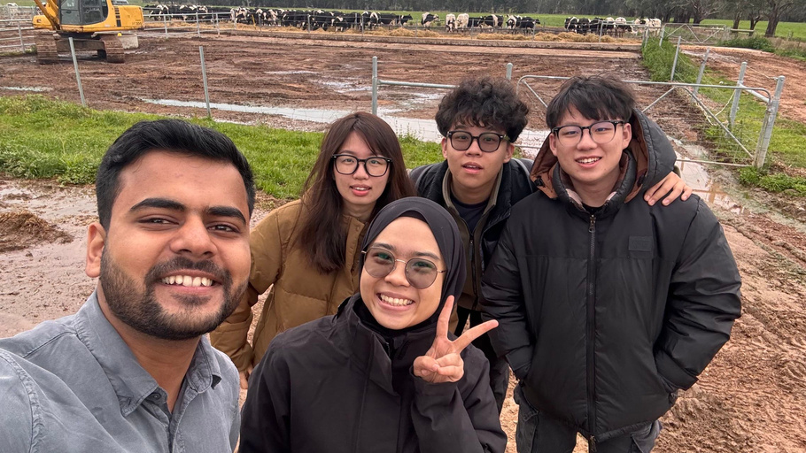
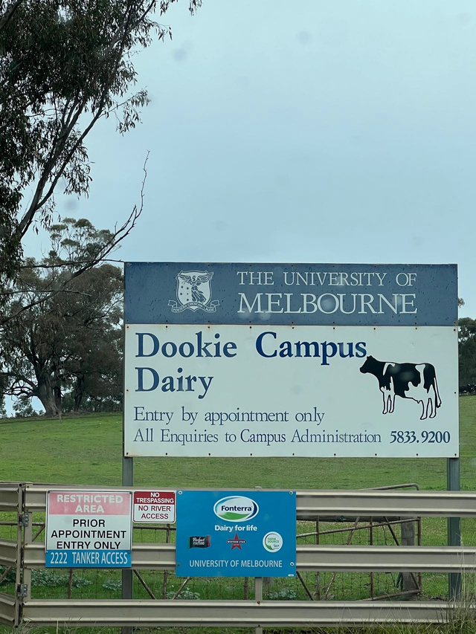
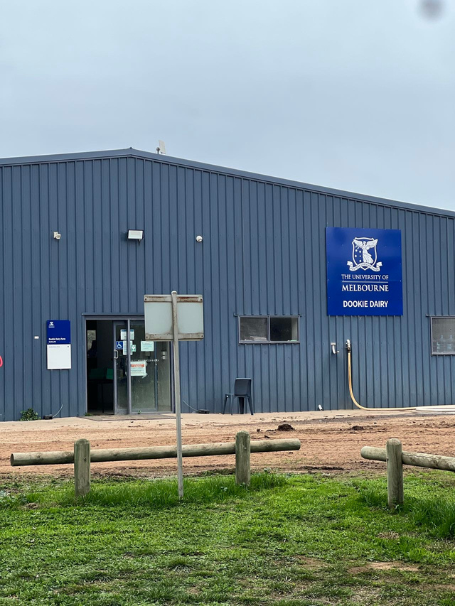
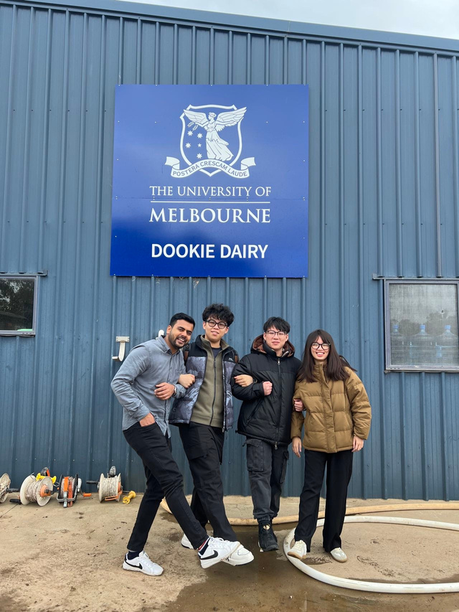
Trip to Dookie Dairy

Slide 5
TABLE OF CONTENTS
Project Overview and Scope
The Lely Horizon application
Key Challenges
Data Science Workflow explained
Data Science Pipeline
Conclusion
Future Scope

Slide 6
PROJECT OVERVIEW AND SCOPE
Analyze extensive data from cow dairy systems.
Address data underutilization in dairy research.
Explore relationships and key drivers of production.
Use data insights to enhance decision-making in dairy processes.
Notes:
Our project analyzes extensive data from cow dairy systems to address data underutilization in dairy research. By identifying relationships and key production drivers, we aim to use this data to enhance decision-making in dairy processes.

Slide 7
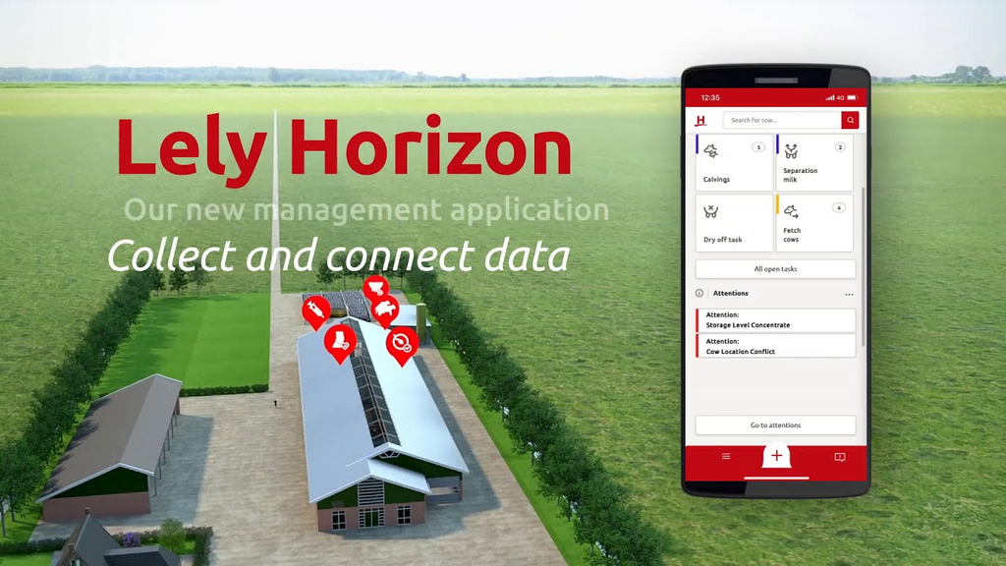

A farm management tool designed to elevate data for forecasting performances and offering clear choices for farming optimization.
Image Source: Lely Horizon, "Connect and Collect Data", Lely. Retrieved from https://www.lely.com/au/solutions/farm-management/horizon/connect-collect/ on May 13, 2024.
Lely
Horizon
Notes:
We use the Lely Horizon application, a farm management tool designed to enhance data utilization, to download our dataset.

Slide 8
KEY CHALLENGES
Data Download Challenges
Challenges in downloading data from the Lely Horizon software included a poor user interface and lack of a user manual, which led to time-consuming setup.
Modeling Results
Data Size
Despite merging datasets, the overall data size was smaller than expected.
Data Size
Modeling Results
The data modeling results fell short of expectations due to the limited data size, highlighting potential challenges ahead.
Data Download
Challenges
Notes:
During our project, we encountered several challenges. The first was the difficulty of downloading data from the Lely Horizon software, which has a poor user interface, making the setup process time-consuming. The second challenge was that the overall data size was smaller than expected when downloading and merging the datasets. Finally, the limited data size impacted the quality of our modeling results, highlighting potential challenges in achieving robust outcomes.

Slide 9
Data Collection
Workflow Explained
Data Processing
Data Installation Guide
Exploratory Data Analysis
Data Modelling
Data Visualization
Model Evaluation
Model Tuning and Optimization
Communication and Report
Notes:
This is the graph of our workflow. We began with data collection and processing, followed by exploratory data analysis. Then, we proceed through three stages. First, we create a data installation guide to help others use the Lely Horizon software more effectively. Next, we perform data modeling, including model evaluation, tuning, and optimization. In the final stage, we focus on data visualization. We combine insights from all three stages to complete our final report.

Slide 10
LITERATURE REVIEW
Decision Support Systems (Ferris et al., 2020; Cabrera et al., 2020): The Dairy Brain system integrates real-time data for farm management decisions, showing how analytics can improve productivity.
Precision Dairy Farming (Wolfert et al., 2017): Big data, IoT, and cloud technologies enhance decision-making and improve efficiency across the dairy supply chain.
Health Monitoring Systems (Andonovic et al., 2016): Wireless sensor networks (WSNs) enable continuous, real-time monitoring of cattle health, improving welfare and management.
Machine Learning for Yield Prediction (Liseune et al., 2020): Recent studies show how deep learning can predict milk yield curves, leveraging historical data and health events to improve accuracy, which supports animal health monitoring and management systems.
Notes:
We reviewed many studies and got some great ideas. Especially the last one, which used a Convolutional neural network and autoencoders to analyze past lactation data and predict future milk production more accurately. By following their approach, we are able to boost the efficiency of our model.

Slide 11
DATA SCIENCE PIPELINE
Data Collection
Exploratory Data Analysis
Data Modeling
Model Evaluation & Optimization
Notes:
Let's take a closer look at our data science pipeline

Slide 12
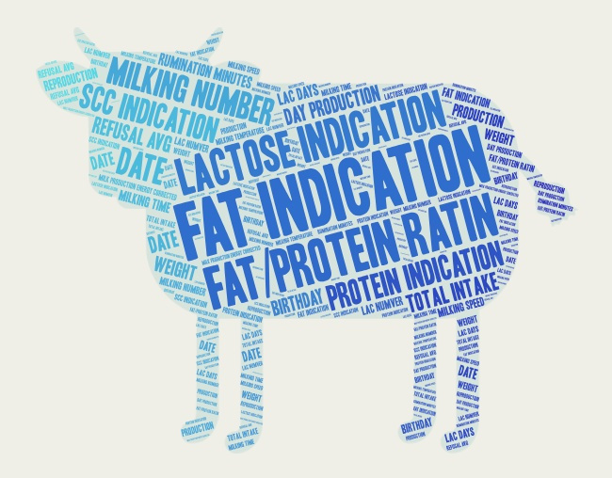
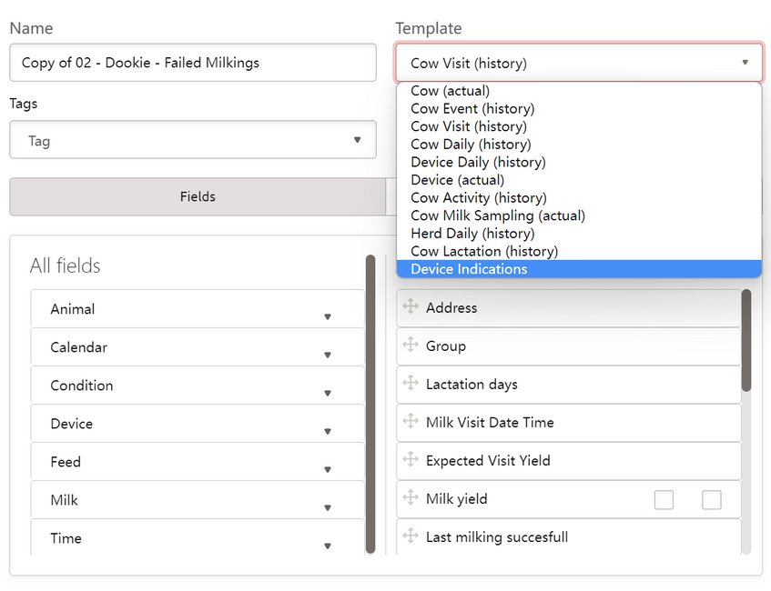
Data Collection
Exploratory Data Analysis
Data Modeling
Model Evaluation & Optimization
Notes:
At the start of the project, our main task was to collect relevant data from Lely Horizon. After discussions with the client, we selected key fields for filtering and narrowed down to two main datasets: herd daily history and device daily history.

Slide 13
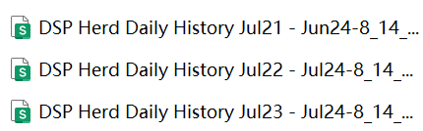

Data Collection
Exploratory Data Analysis
Data Modeling
Model Evaluation & Optimization
Device Daily History & Herd Daily History
Data merging
Handling missing values
Filling missing values
Handling outliers
Notes:
At this stage, we focused on data cleaning and preprocessing.
We merged data from several Excel files into one unified dataset.

Slide 14
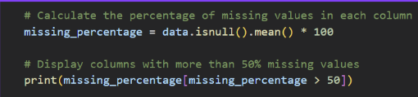
Data Collection
Exploratory Data Analysis
Data Modeling
Model Evaluation & Optimization
Device Daily History & Herd Daily History
Data merging
Handling missing values
Filling missing values
Handling outliers
Notes:
Next, we tackled missing values by checking how much data was missing in each field.
For fields like time milking, which had over 50% missing data, we decided to remove them.

Slide 15
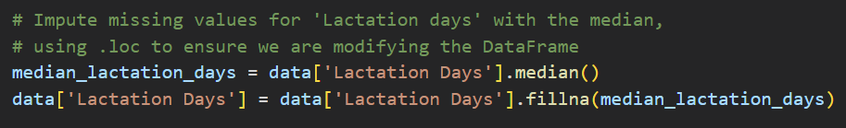
Data Collection
Exploratory Data Analysis
Data Modeling
Model Evaluation & Optimization
Device Daily History & Herd Daily History
Data merging
Handling missing values
Filling missing values
Handling outliers
Notes:
For key fields like Lactation Days, instead of deleting records, we filled in missing values using the median.

Slide 16
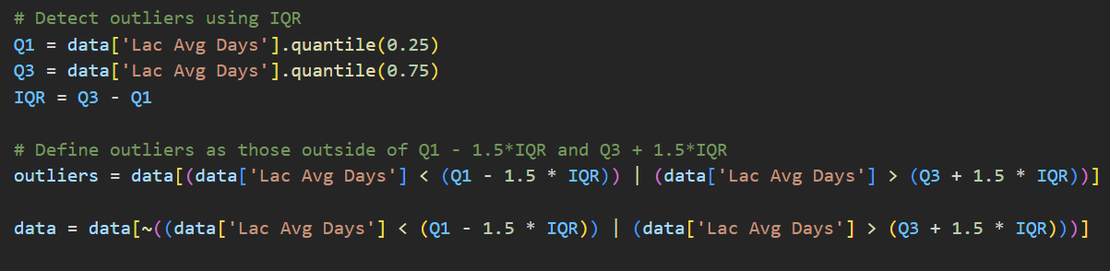
Data Collection
Exploratory Data Analysis
Data Modeling
Model Evaluation & Optimization
Device Daily History & Herd Daily History
Data merging
Handling missing values
Filling missing values
Handling outliers
Notes:
We also dealt with outliers by using the Interquartile Range method, which helped us identify and remove values that fell outside the expected range.

Slide 17
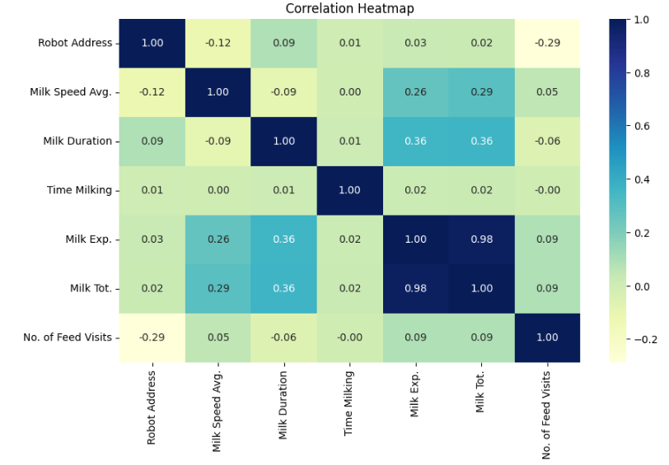
Data Collection
Exploratory Data Analysis
Data Modeling
Model Evaluation & Optimization
Device Daily
Correlation Analysis
Notes:
We started by running a correlation analysis to explore the relationships between variables. For example, This heatmap showed that Milk Duration has a moderate positive correlation with Milk Total. Based on this map, we selected features like Milk Duration, Milk Speed Average, and so on to build our models.

Slide 18
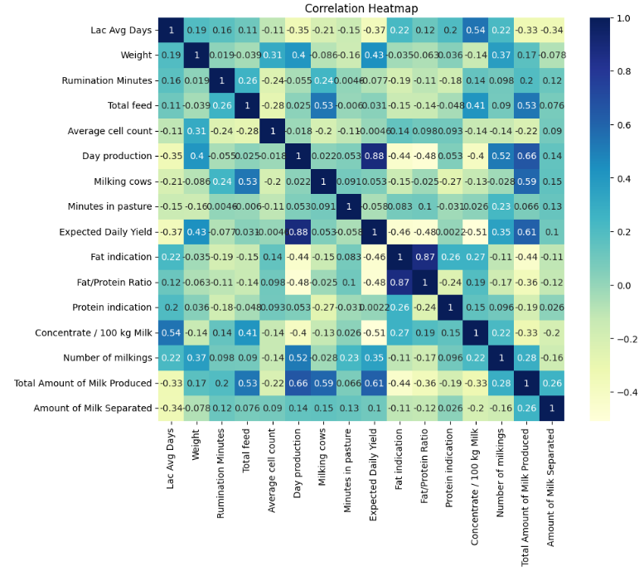
Data Collection
Exploratory Data Analysis
Data Modeling
Model Evaluation & Optimization
Herd Daily History
Correlation Analysis
Notes:
For this chart, we found some key factors like The number of milkings, weight, and feed intake all have a significant impact. Adjusting these factors can help improve milk production.
now yuqian will explain next part

Slide 19
Modeling Techniques
Time Series Analysis
Polynomial Regression
Machine Learning Models
Notes:
We will go through three different modeling techniques. I will introduce time series analysis first.

Slide 20
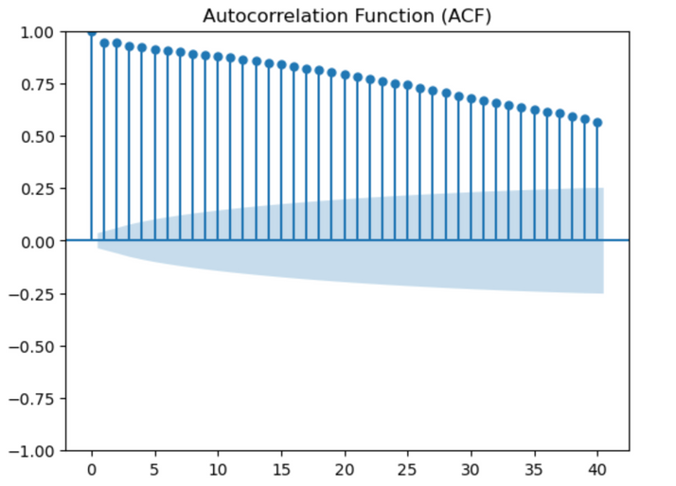
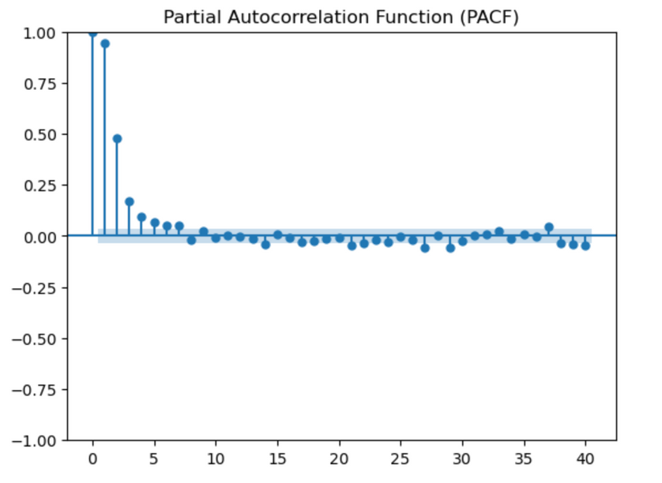
Data Collection
Exploratory Data Analysis
Data Modeling
Model Evaluation & Optimization
TIME SERIES ANALYSIS
A time series is a sequence of data points collected or recorded at successive points in time, typically at regular intervals, such as hourly, daily, monthly, or annually. Time series analysis helps to model and forecast future values based on past observations and is commonly used in applications such as stock market prediction, weather forecasting, and demand planning (Chatfield, 2003).
Chatfield, C., & Xing, H. (2019). The analysis of time series: an introduction with R. Chapman and hall/CRC.
These plots help to identify the appropriate AR (Auto-Regressive) and MA (Moving Average) terms.
MA order (q): 1 or 2 (based on the ACF plot)
AR order (p): 1 (based on the PACF plot)
Notes:
A time series is a sequence of data points collected or recorded at successive points in time. We use ACF and PACF plots to identify Auto-Regressive and Moving Average terms, with an MA order (q) of 1 or 2 suggested by the ACF plot, and an AR order (p) of 1 indicated by the PACF plot.

Slide 21
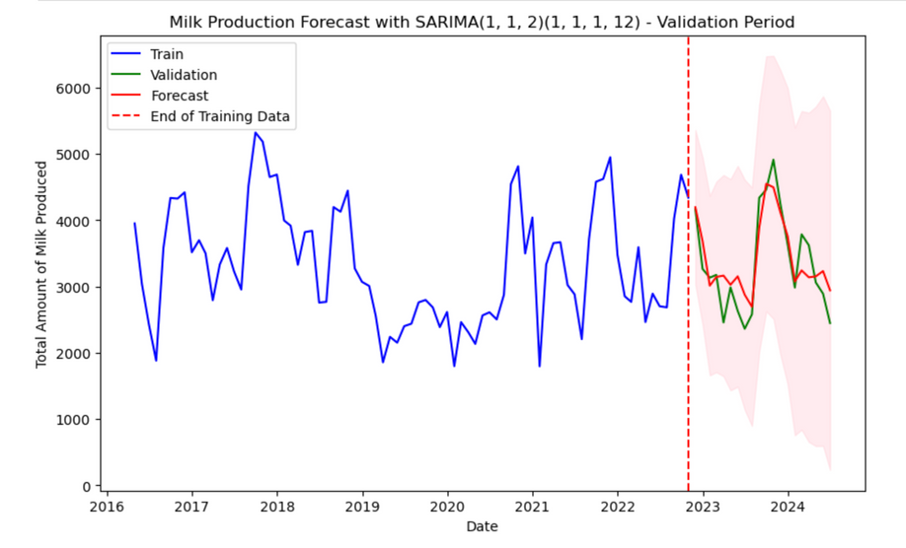
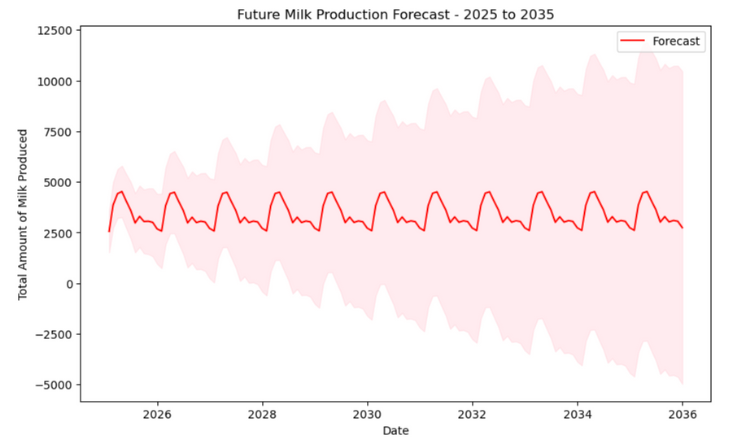

Data Collection
Exploratory Data Analysis
Data Modeling
Model Evaluation & Optimization
SARIMA
This chart presents a SARIMA model forecast for milk production using the SARIMA(1,1,2)(1,1,1,12) model. The blue line represents the training data, while the green line shows the validation period, separated by a red dashed line marking the end of the training phase. The forecasted values are shown in red, with shaded areas indicating the forecast’s uncertainty range. The close alignment between the forecasted and validation data suggests that the model is accurate, making it suitable for predicting milk production trends over the next 10 years.
The final milk predictions for 2025 to 2035
Notes:
The final time series model we used is a SARIMA model. We chose this model because, as shown in the top-right graph, the forecasting test results do not have significant differences from the validation data. Therefore, we used this model to predict future milk production from 2025 to 2035.
I will let Clark talk about polynomial regression.

Slide 22
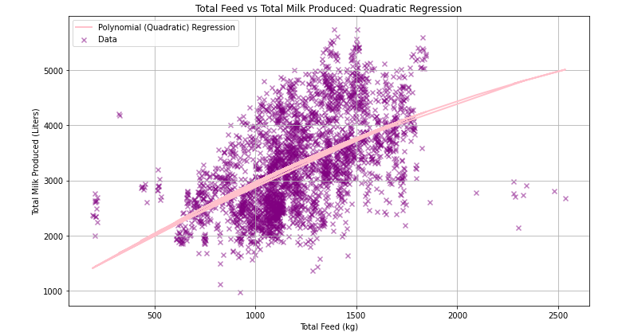
Data Collection
Exploratory Data Analysis
Data Modeling
Model Evaluation & Optimization
Quadratic and Higher-Order Polynomial Regression
The relationship between feed consumption and milk yield shows a non-linear growth in the quadratic regression. After reaching the critical point, the marginal benefit of increasing feed decreases.
Notes:
Slide 22:
now i will introduce polynomial regression
First we select two feature, total feed and total milk produced to establish model
The relationship between feed consumption and milk yield shows a non-linear growth in the quadratic regression. After reaching the critical point, the marginal benefit of increasing feed decreases.

Slide 23
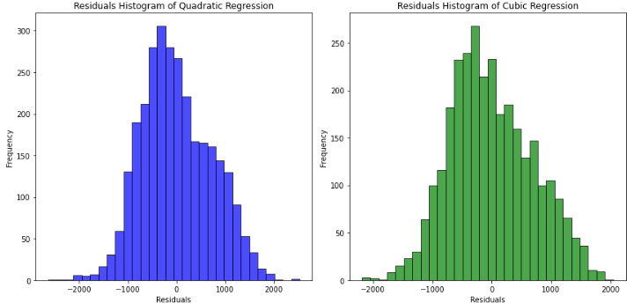
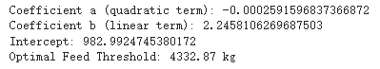
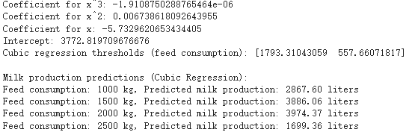
Data Collection
Exploratory Data Analysis
Data Modeling
Model Evaluation & Optimization
01：
Quadratic Regression Results
02：
Cubic Regression Results:
Notes:
Quadratic term (a) is Negative, indicating diminishing milk production after a certain feed intake level.
Linear term (b) is Positive, showing that initially, increased feed raises milk production.
Intercept: Baseline milk production is 982 liters when feed intake is zero.
Optimal feed intake: Maximum milk production at 4332 kg of feed, further increases reduce yield.
Cubic Regression Explanation:
Cubic term is Negative, capturing a complex relationship with multiple inflection points.
Quadratic term is Positive, which means initial acceleration in milk production.
Linear term is Negative that suggesting slower growth and possible decline after a threshold.
Intercept: Baseline production is 3772.81 liters at zero feed.
critical point which means Two feed levels where milk production peaks or drops.
from Residual Histograms:
Quadratic regression shows near-normal residuals with some bias. Cubic regression offers a better fit, with more balanced, centered residuals, making it better for complex data.

Slide 24
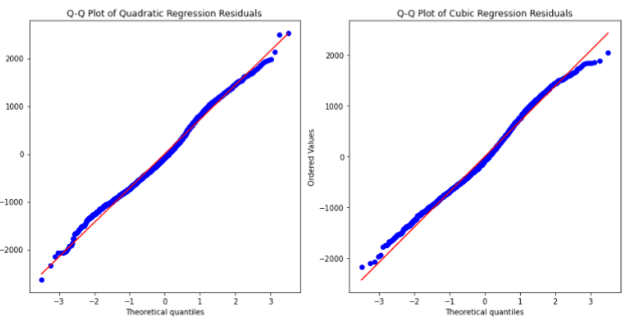
Data Collection
Exploratory Data Analysis
Data Modeling
Model Evaluation & Optimization
Comparison of the different order models:
Good normality with most points near the diagonal, but extreme residuals show a poor fit.
Nonlinearity, noise, and unconsidered factors (like cattle health or weather) make it hard to explain all variations.
Simple models miss patterns, while complex ones overfit.
Quadratic Regression Model: The quadratic regression model has an R² value of 0.284
Cubic Regression Model: The cubic regression model improves slightly, with an R² value of 0.326
Quartic Regression Model: Despite adding more non-linear terms, the quartic regression model has the same R² value of 0.326 as the cubic model
Notes:
The QQ plots of quadratic and cubic regression models indicate good normality, with most points close to the diagonal. However, residuals in extreme regions deviate, suggesting deficiencies in fit.
The models struggle to explain all variations due to nonlinearity, noise, and unconsidered factors like cattle health or weather.
Simple models may miss patterns, while complex ones overfit.
Quadratic Model: R² = 0.284, captures some non-linear trends but limited explanatory power.
Cubic Model: R² = 0.326, shows a better fit for the non-linear relationship.
Quartic Model: no improvement over the cubic model despite added complexity.
So we just compare Quadratic with Cubic regression model
Complexity: Quadratic is simpler with one critical point, while cubic captures multiple points and more detailed effects. Cubic is better for modeling complex trends, while quadratic only reflects one growth-to-decline transition. Quadratic shows 4332.87 kg as optimal, cubic gives two points (557.66 kg and 1793.31 kg), reflecting different stages.
so cubic captures more details, but quadratic is easier to interpret.

Slide 25
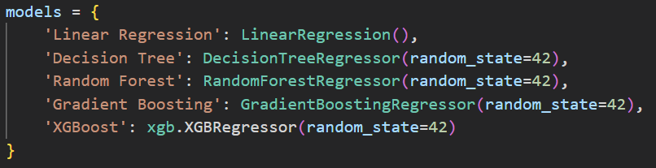
Data Collection
Exploratory Data Analysis
Data Modeling
Model Evaluation & Optimization
Model Selection
Notes:
Now, let's move on to the model selection process. As part of our workflow, we tried various machine learning models on both datasets—the Herd Daily and Device Daily datasets. We evaluated the models based on standard performance metrics, focusing primarily on Mean Squared Error (MSE), which measures the average squared difference between actual and predicted values, and R-squared (R²), which tells us how much of the variance in the target variable is explained by the model.

Slide 26
Data Collection
Exploratory Data Analysis
Data Modeling
Model Evaluation & Optimization
Herd Daily History：
Linear Regression:
MSE: 3.141
R² Score: 0.83
Decision Tree Regression:
MSE: 2.42
R² Score: 0.87
Random Forest:
MSE: 0.89
R² Score: 0.95
Gradient Boosting:
MSE: 1.36
R2: 0.93
XGBoost:
MSE: 0.90
R2: 0.95
Best Model：
Random Forest
Notes:
For the Herd Daily dataset, we tested models like Linear Regression, Decision Trees, Random Forest, and Gradient Boosting. Among these, the Random Forest model stood out as the best performer. It achieved an MSE of 0.89 and a very high R² of 0.95, meaning it explained 95% of the variance in milk production. This makes Random Forest a highly effective model for this dataset, as it captured most of the data's complexity and provided reliable predictions.

Slide 27
Data Collection
Exploratory Data Analysis
Data Modeling
Model Evaluation & Optimization
Device Daily History：
Linear Regression:
MSE: 41690.78
R2: 0.24
Decision Tree:
MSE: 10156.46
R2: 0.82
Random Forest:
MSE: 5403.17
R2: 0.90
Gradient Boosting:
MSE: 5207.27
R2: 0.91
XGBoost:
MSE: 5638.06
R2: 0.89
Best Model：
Gradient Boosting
Notes:
On the other hand, for the Device Daily dataset, we found that the Gradient Boosting model performed the best. This model had an MSE of 5207 and an R² of 0.91. Although the error rate was higher compared to the Herd Daily dataset, the model still explained 91% of the variance, making it a strong predictive model. However, the higher MSE indicates that the Device Daily dataset has greater variability or complexity, which requires further attention.

Slide 28
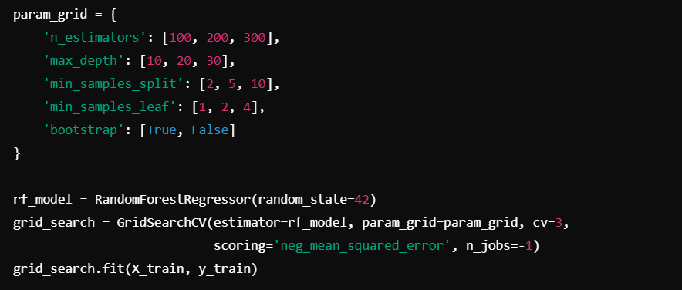
Data Collection
Data Cleaning & Preprocessing
Data Analysis & Modeling
Model Evaluation & Optimization
Model Optimization:
We used GridSearchCV to optimize hyperparameters for both Random Forest and Gradient Boosting models, fine-tuning key parameters to minimize the Mean Squared Error (MSE) on the training set.
Total number of combinations tried: -
n_estimators: 3 options
max_depth: 3 options
min_samples_split: 3 options
learning_rate: 3 options
subsample: 2 options
Total combinations = 3×3×3×3×2=162
Notes:
So after Finding the best model we need to find the best model parameter for that we use gridsearchcv and test different parameters which results in 162 different model combinations.

Slide 29
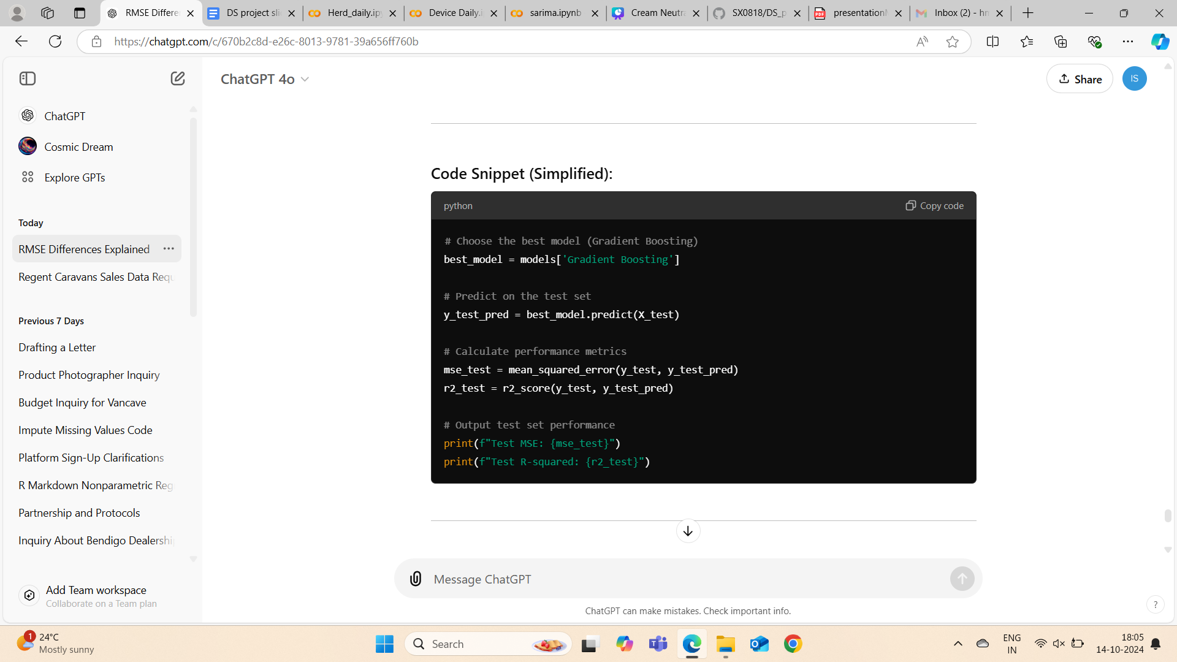
Data Collection
Data Cleaning & Preprocessing
Data Analysis & Modeling
Model Evaluation & Optimization
Model Evaluation:
For both the Device Daily and Herd Daily datasets, the same process was followed to select and evaluate the best model (Gradient Boosting) on the test set. The process involves predicting on the test set and calculating key performance metrics.
Key Steps in Model Evaluation:
Select Best Model
Prediction on Test Set
Performance Metrics
Test Set Evaluation
Notes:
Overall, in both cases, we followed a consistent approach: testing multiple models, optimizing them through hyperparameter tuning, and selecting the model that offered the best balance of accuracy and generalization.

Slide 30
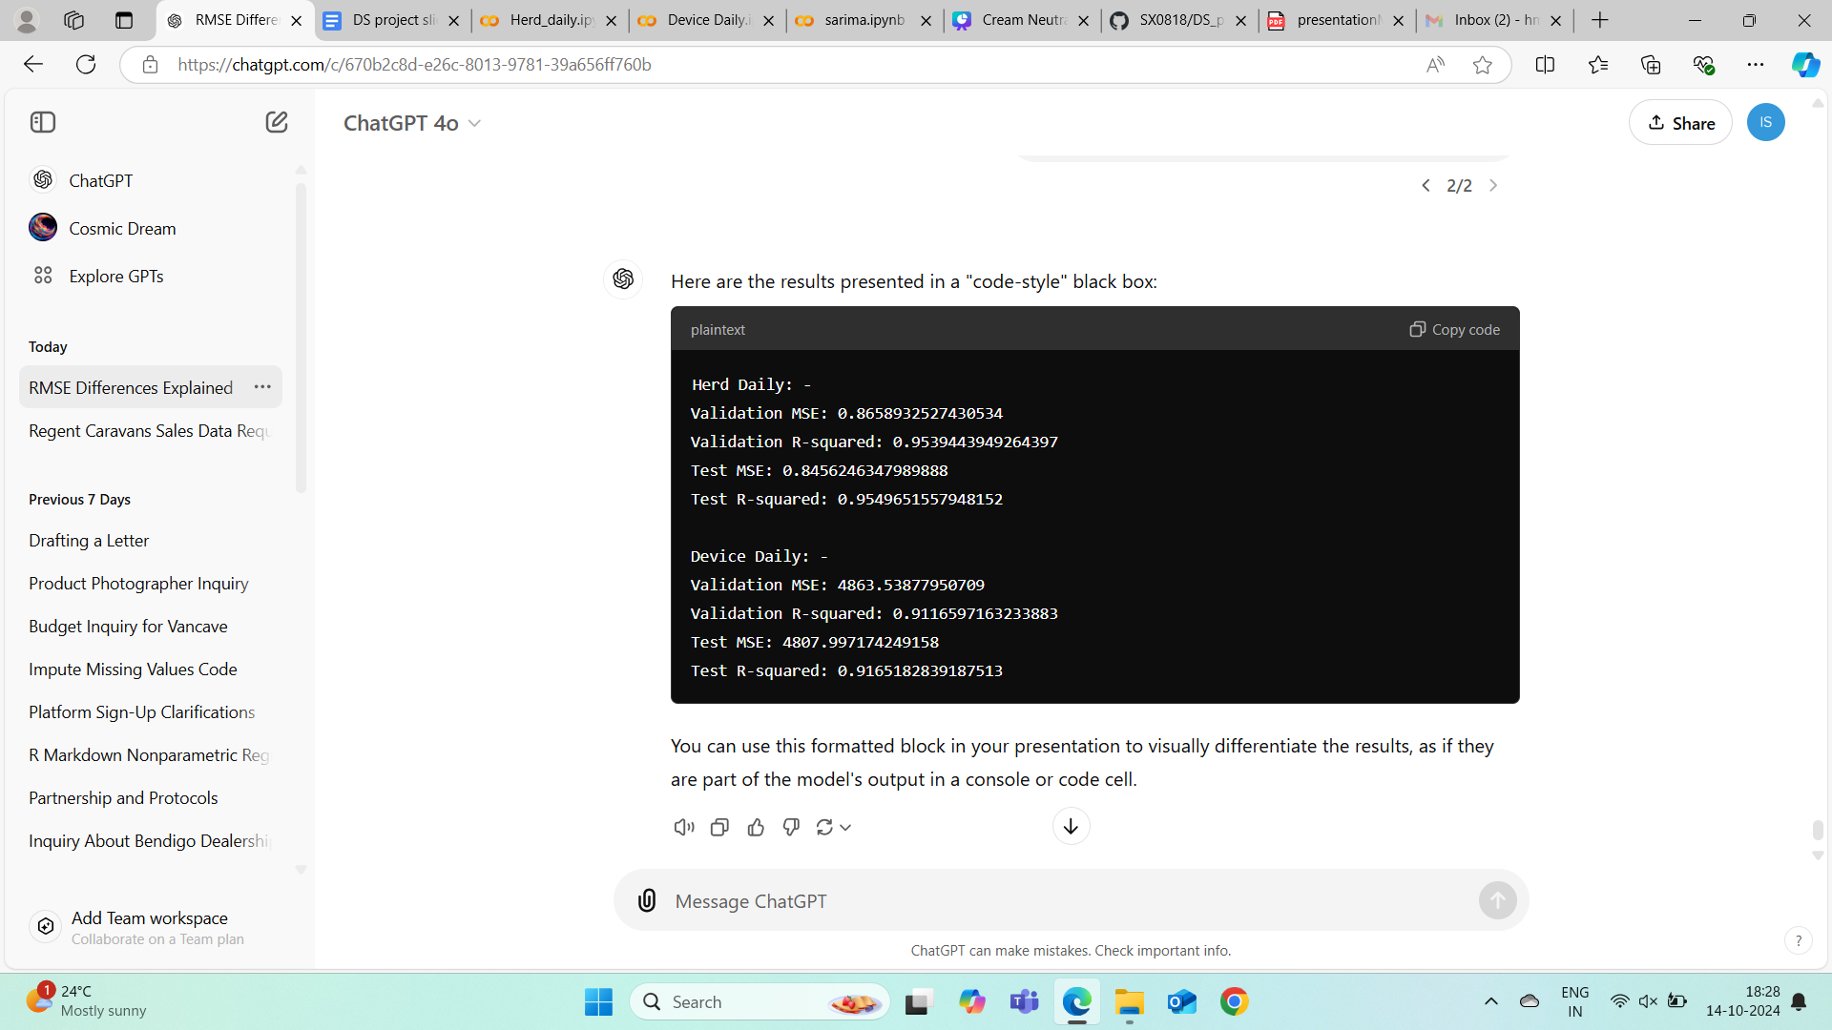
Data Collection
Data Cleaning & Preprocessing
Data Analysis & Modeling
Model Evaluation & Optimization
Results of Modeling:
The Herd Daily dataset exhibits superior predictive performance, with a near-perfect fit (high R² and low MSE).
The Device Daily dataset also shows good predictive performance, but the higher MSE reflects a larger spread in the target variable. However, the R² score indicates that the model explains over 91% of the variance.
Notes:
Let’s review the modeling results. For the Herd Daily dataset, the Random Forest model showed excellent predictive accuracy, with a low MSE and a near-perfect R² score, making it ideal for predicting milk production and optimizing operations.
In the Device Daily dataset, the Gradient Boosting model performed best, explaining 91% of the variance with an R² of 0.91. However, the higher MSE indicates some prediction error, likely due to the dataset's complexity.
Despite this, Gradient Boosting provided valuable insights, highlighting machine learning’s ability to handle complex data, though further refinement or more data may improve performance.

Slide 31
Conclusion
In this project, we applied multiple modeling techniques, including time series analysis, polynomial regression, and machine learning models:
Time Series Analysis (e.g., SARIMA) effectively forecasted trends in milk production, showing strong alignment with validation data.
Polynomial Regression (quadratic, cubic, quartic) explained some variance, but higher-order terms (quartic) provided minimal improvement, indicating limited usefulness for complex patterns.
Machine Learning Models (Random Forest, Gradient Boosting) delivered the best performance, particularly for the Herd Daily dataset, with high R² (~0.95) and low MSE. However, Device Daily exhibited higher MSE, suggesting the need for additional features or refinement.
Machine learning methods were most effective, while time series offered strong predictive capabilities for future trends.

Slide 32





Future Scope
Integrate additional data source
Implement real-time data monitoring and prediction systems
Explore more sophisticated models
Extend time series forecasting
Focus on creating new features
Notes:
Integrate additional data sources (e.g., weather, feed quality) to improve model accuracy, especially for the Device Daily dataset, where variability is high.
Implement real-time data monitoring and prediction systems to enhance decision-making for dairy production and device management.
Explore more advance models like deep learning or hybrid models to capture non-linear relationships and improve predictive performance, particularly for datasets with complex patterns.
Extend time series forecasting to predict long-term trends, helping optimize farm operations and anticipate future challenges in dairy production.
Focus on creating new features that capture more complex relationships, such as combining existing features or using domain knowledge to create more meaningful variables.

Slide 33
Q & A
Notes:
Integrate additional data sources (e.g., weather, feed quality) to improve model accuracy, especially for the Device Daily dataset, where variability is high.
Implement real-time data monitoring and prediction systems to enhance decision-making for dairy production and device management.
Explore more advance models like deep learning or hybrid models to capture non-linear relationships and improve predictive performance, particularly for datasets with complex patterns.
Extend time series forecasting to predict long-term trends, helping optimize farm operations and anticipate future challenges in dairy production.
Focus on creating new features that capture more complex relationships, such as combining existing features or using domain knowledge to create more meaningful variables.

Slide 34
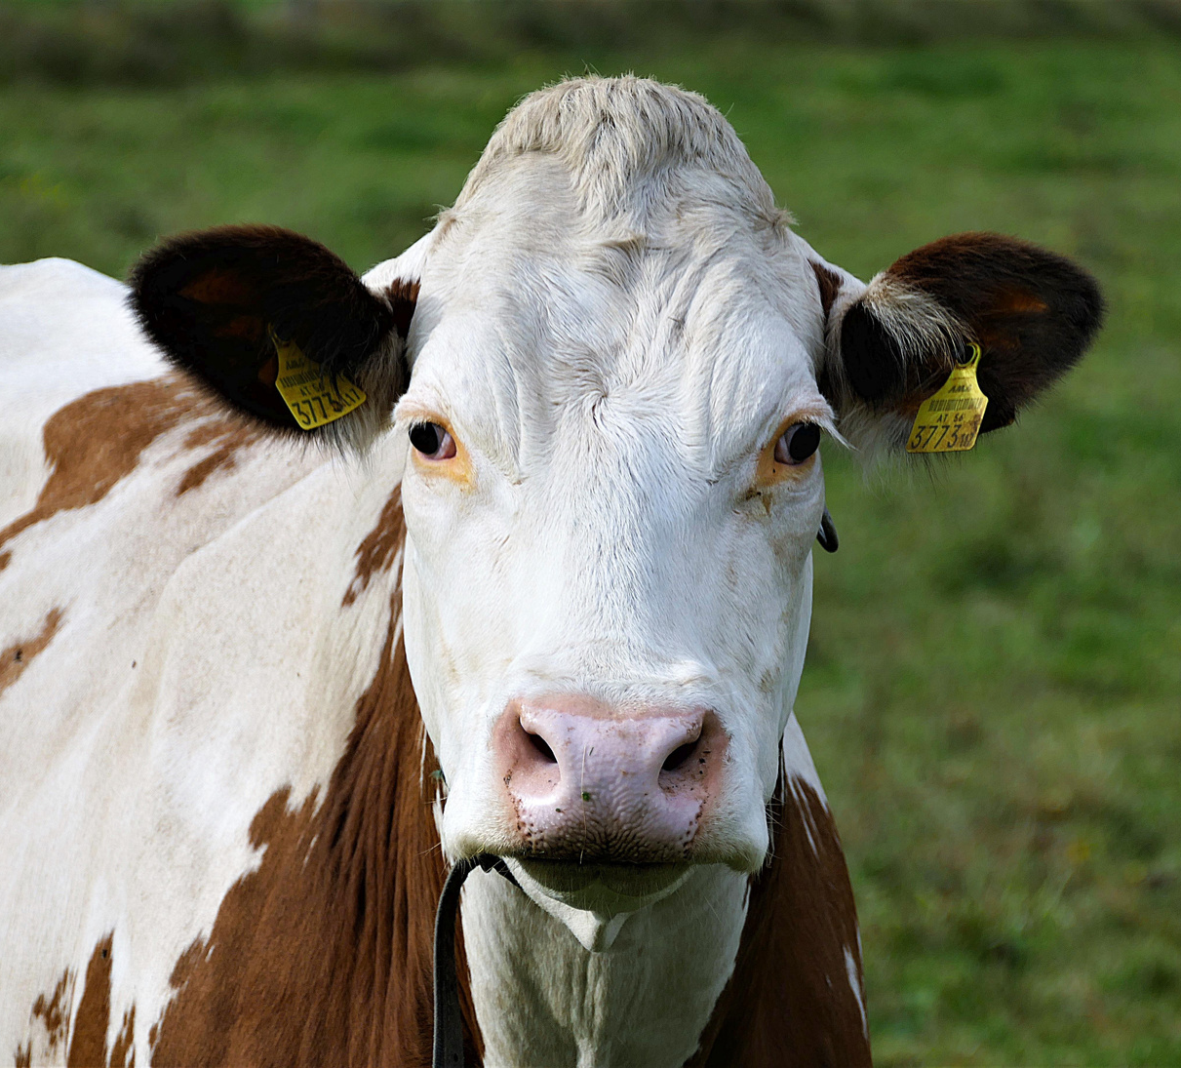
Thank you for watching & listening！

